Slide 1
ne_low
Low Deployment Scenario

Slide 2
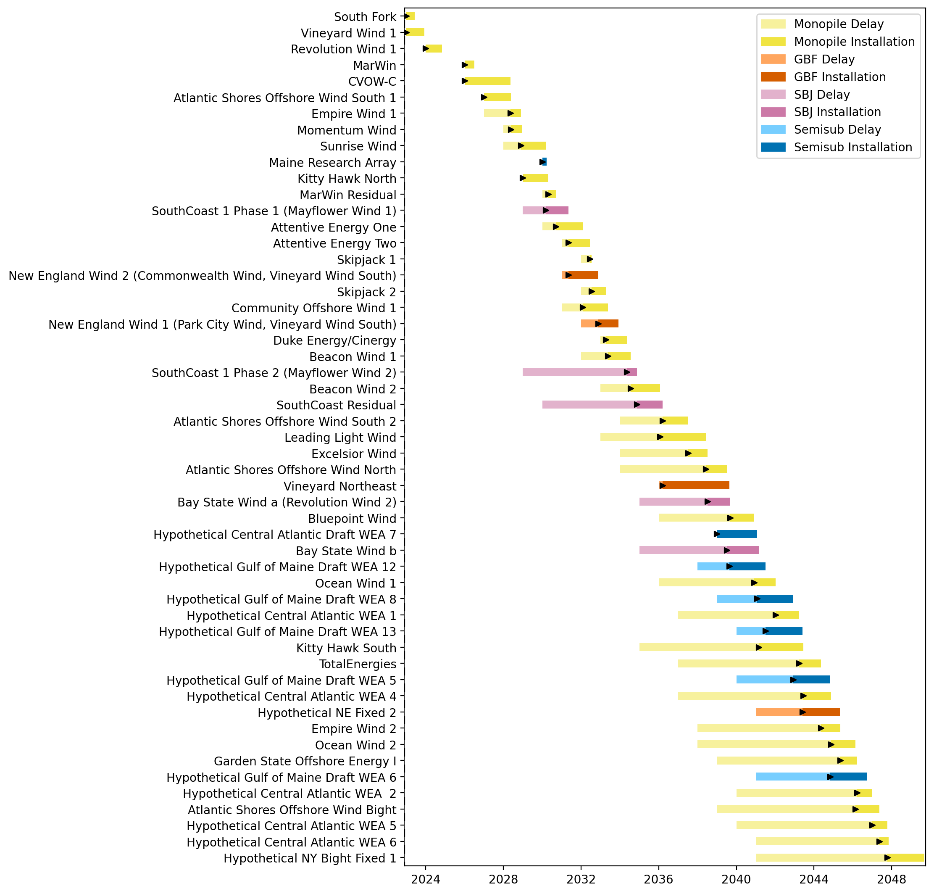
Full Gantt

Slide 3
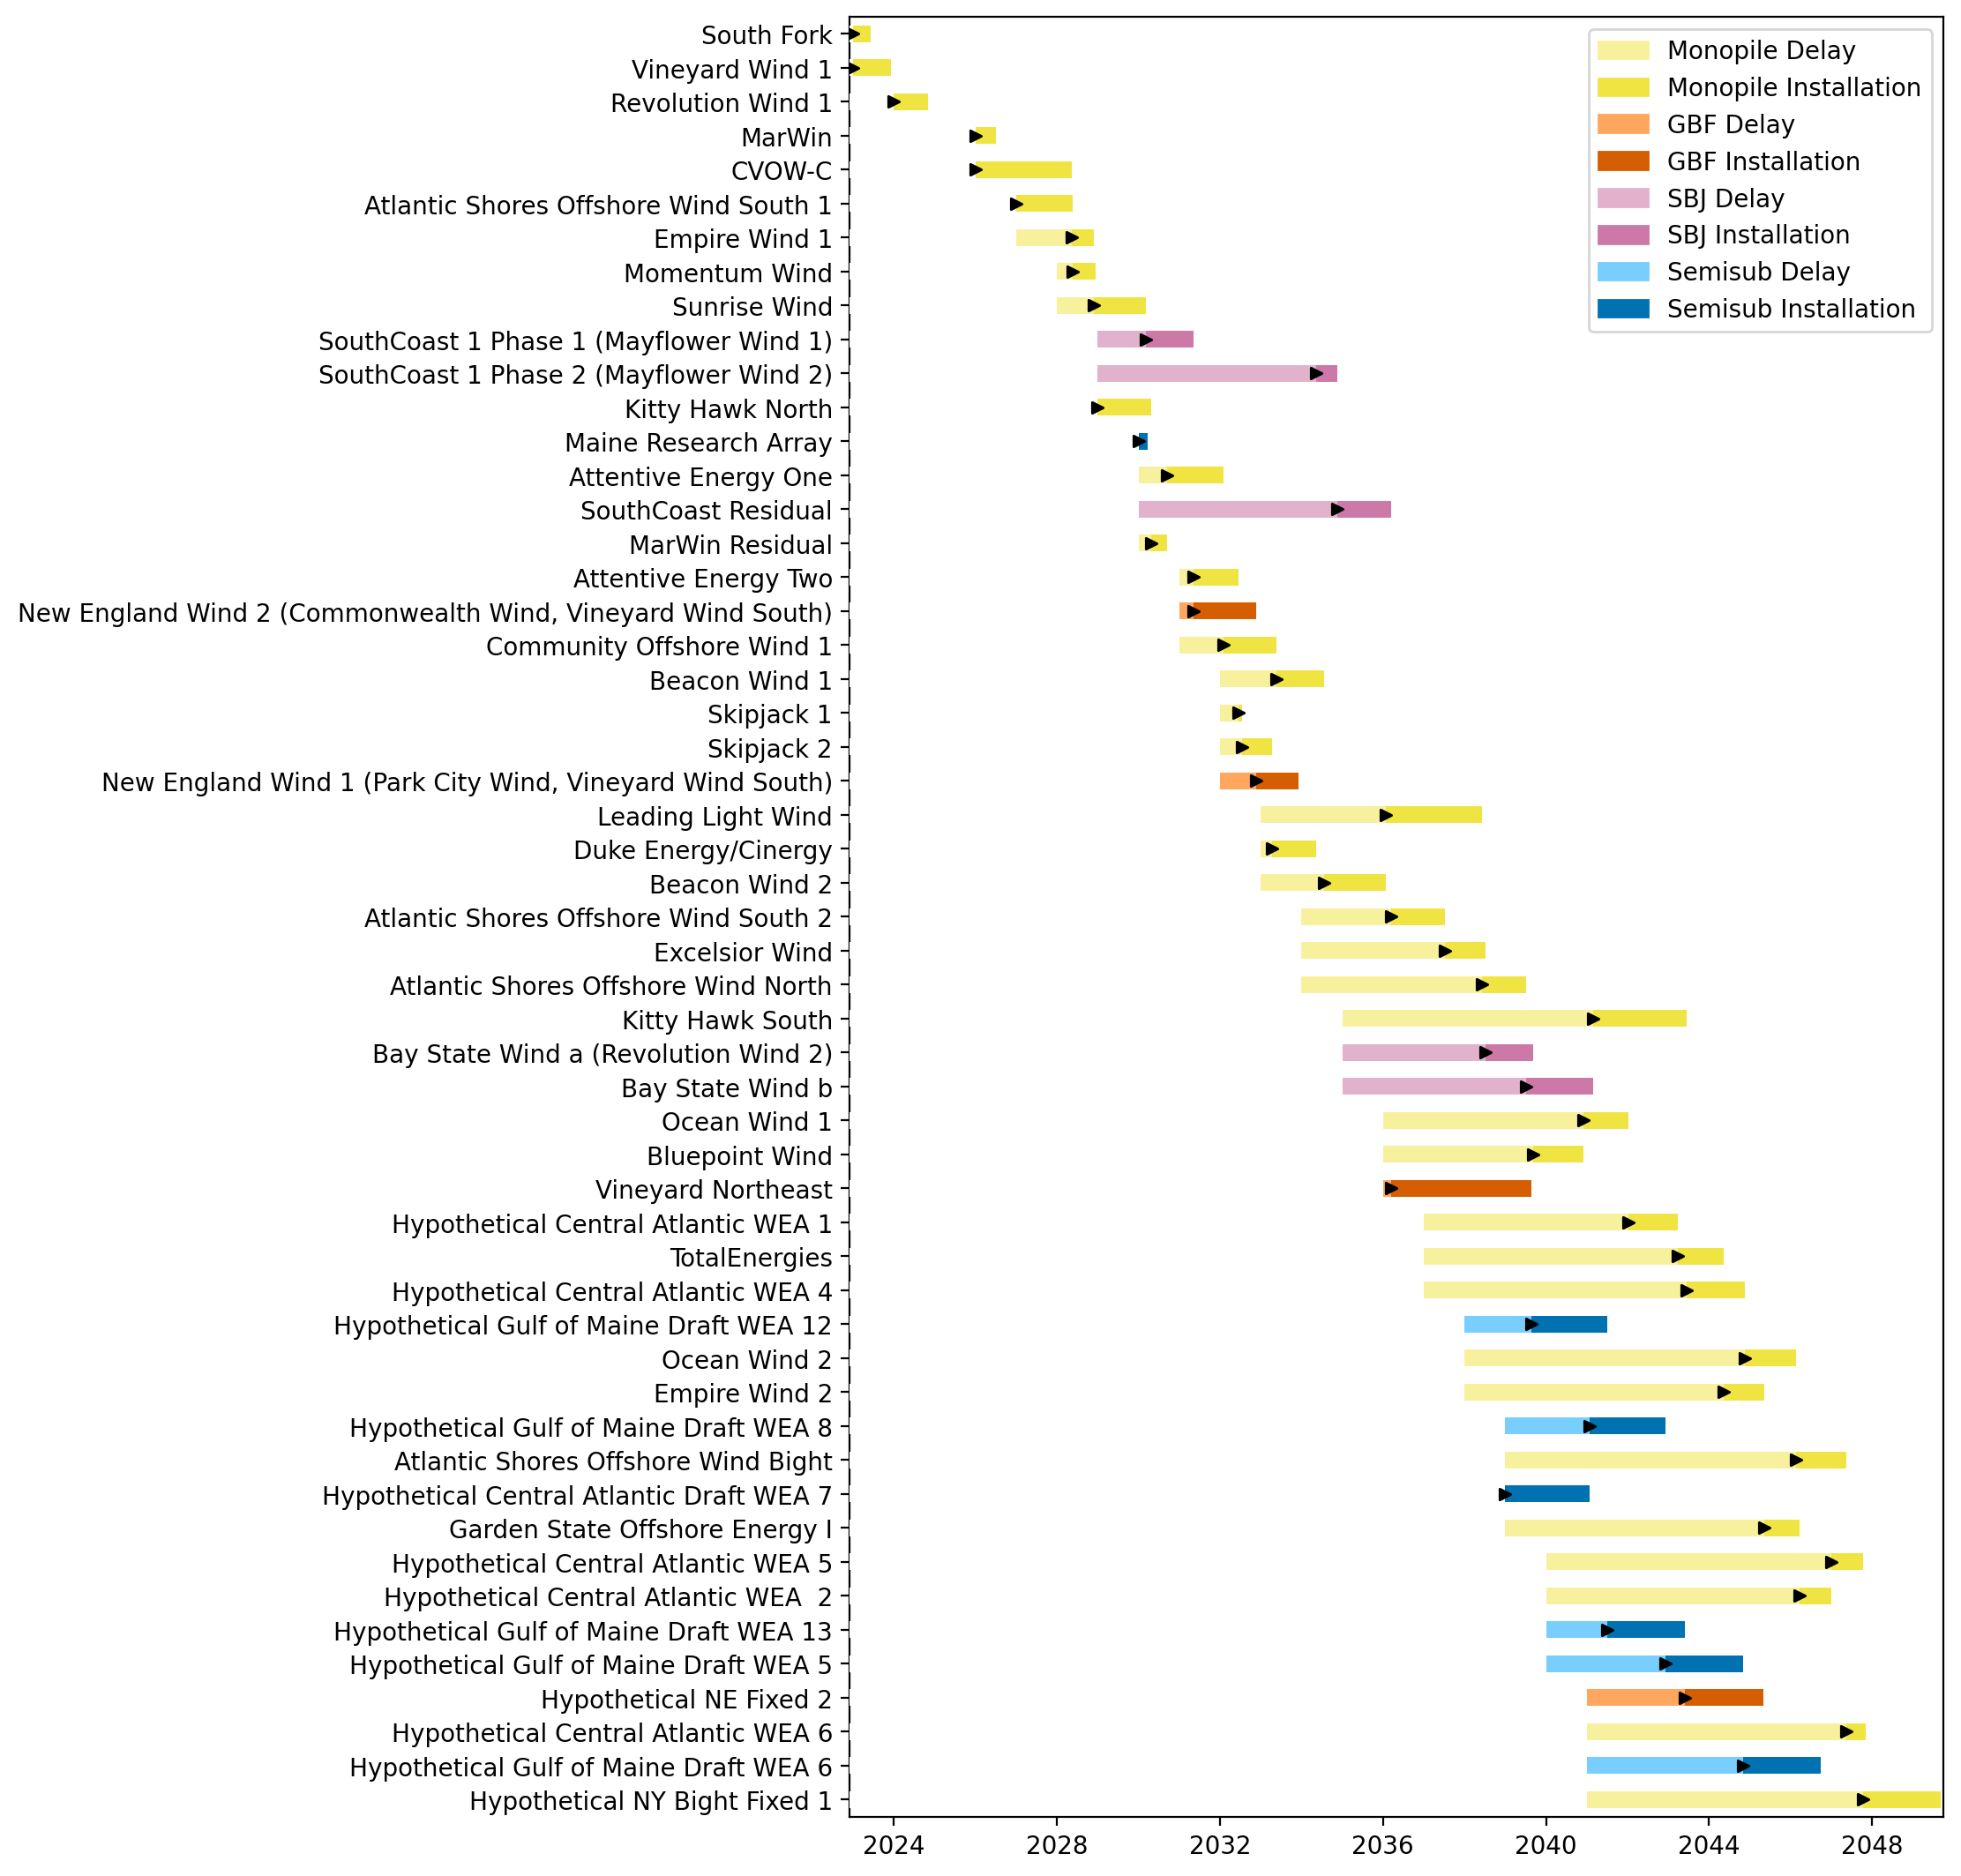
Sorted Full Gantt

Slide 4
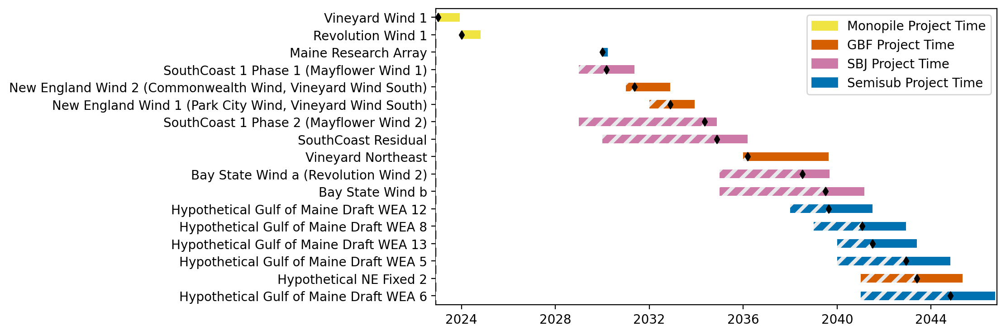
New England Gantt

Slide 5
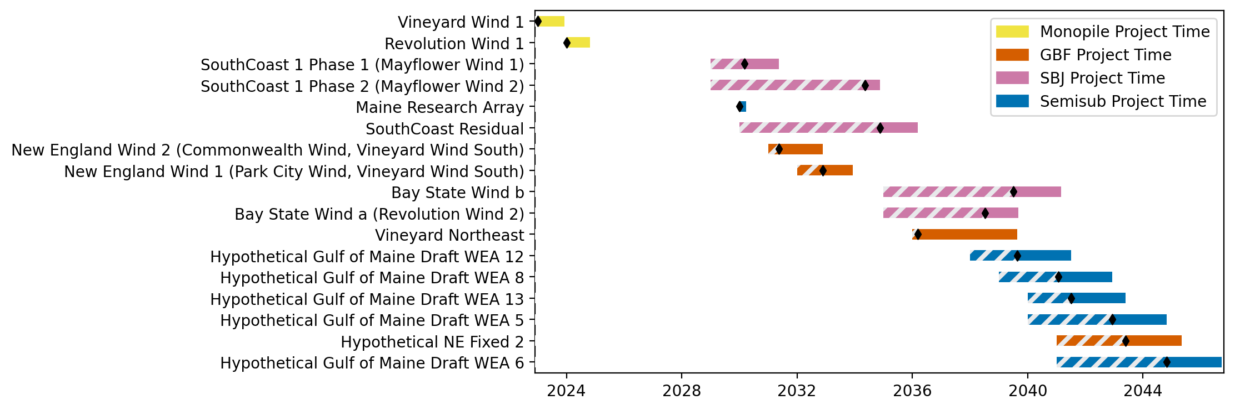
Sorted New England Gantt

Slide 6
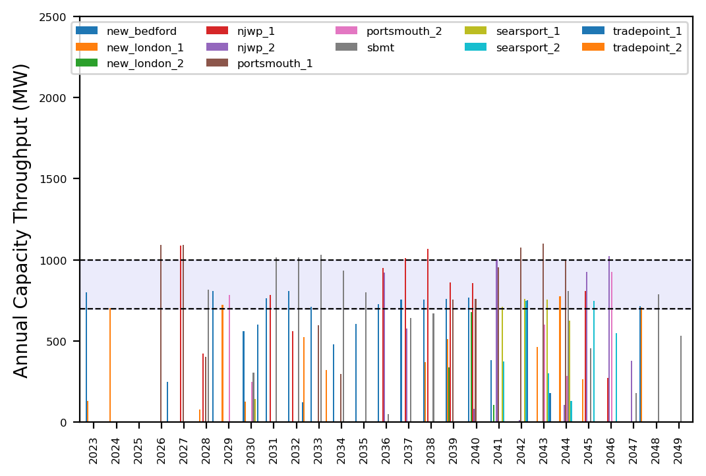
Port Throughput

Slide 7
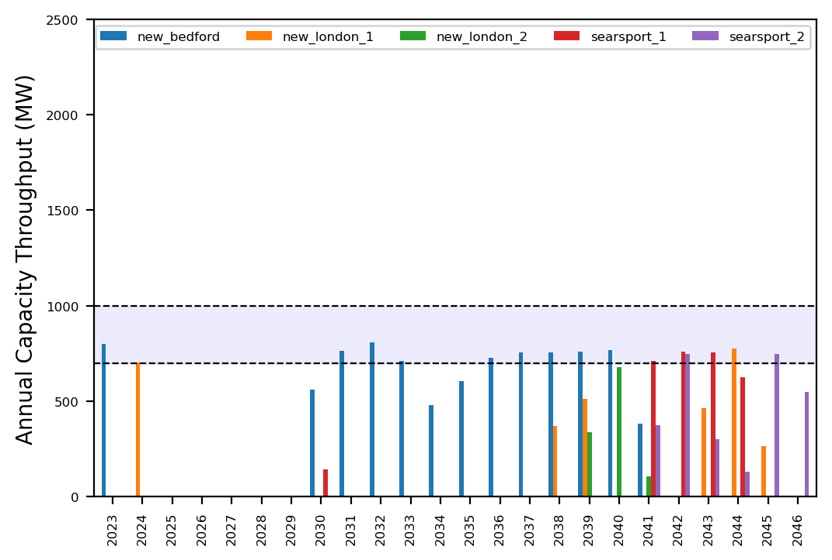
Port Throughput

Slide 8
ne_low_3wtiv_2ahts
Low Deployment Scenario

Slide 9
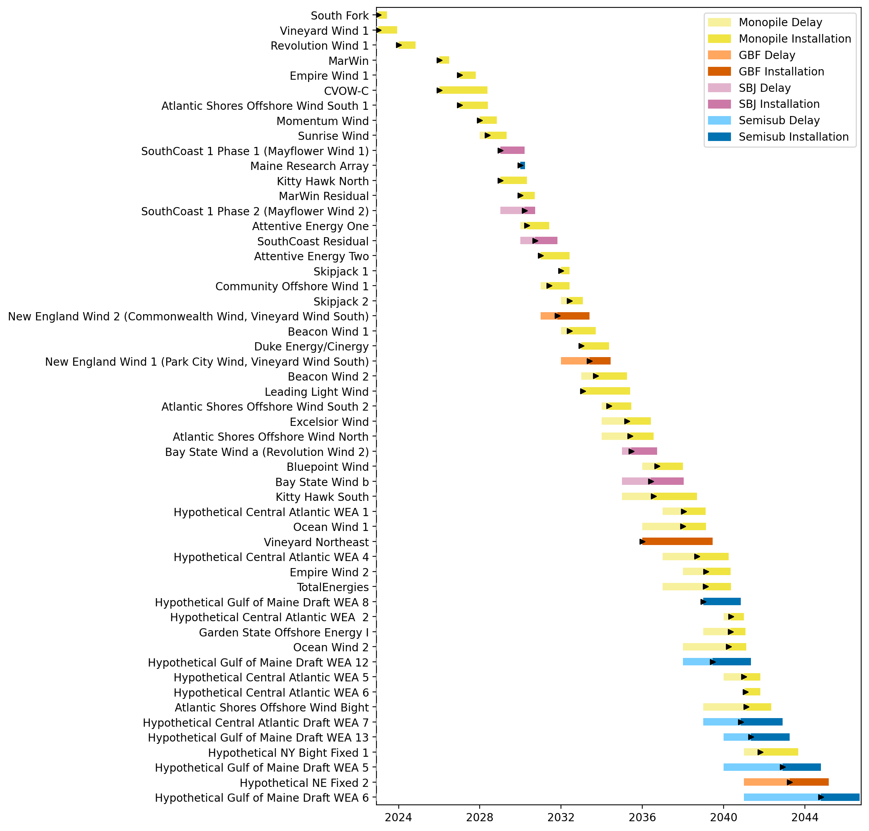
Full Gantt

Slide 10
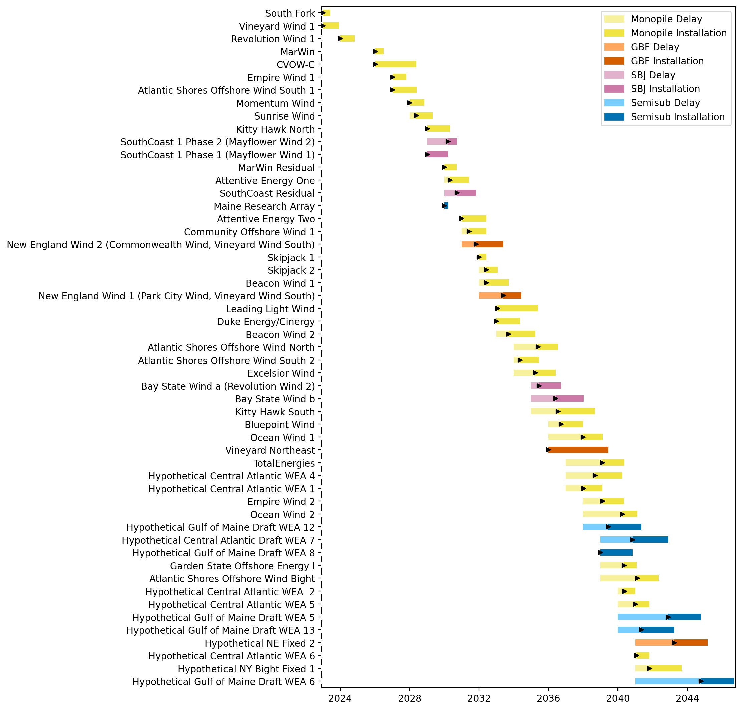
Sorted Full Gantt

Slide 11
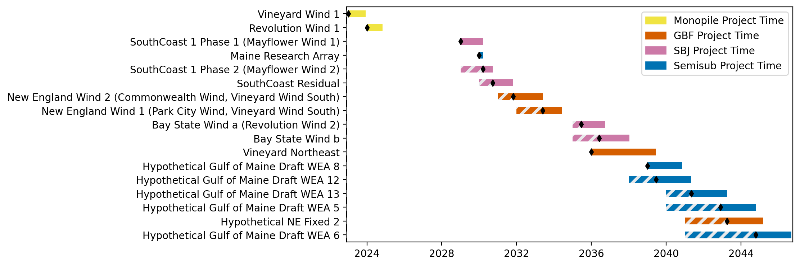
New England Gantt

Slide 12
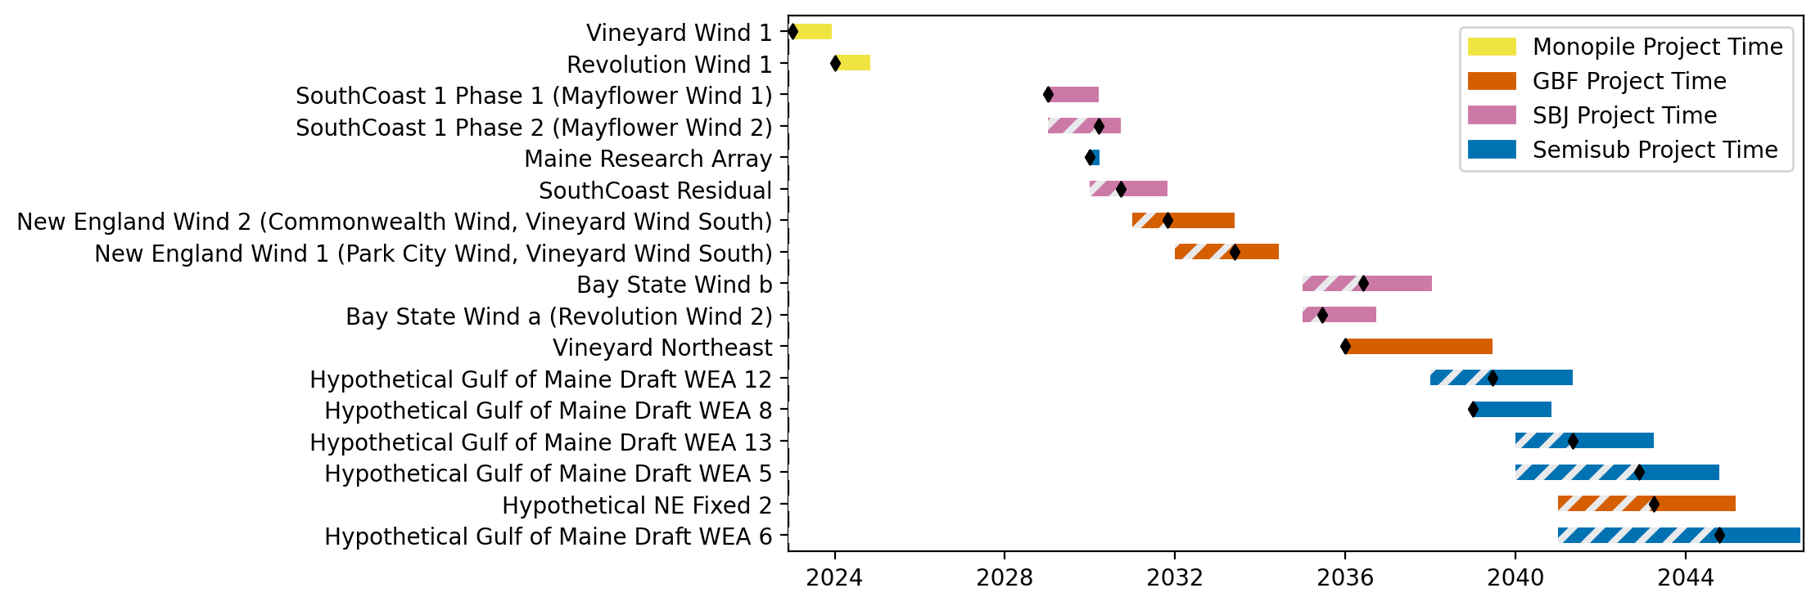
Sorted New England Gantt

Slide 13
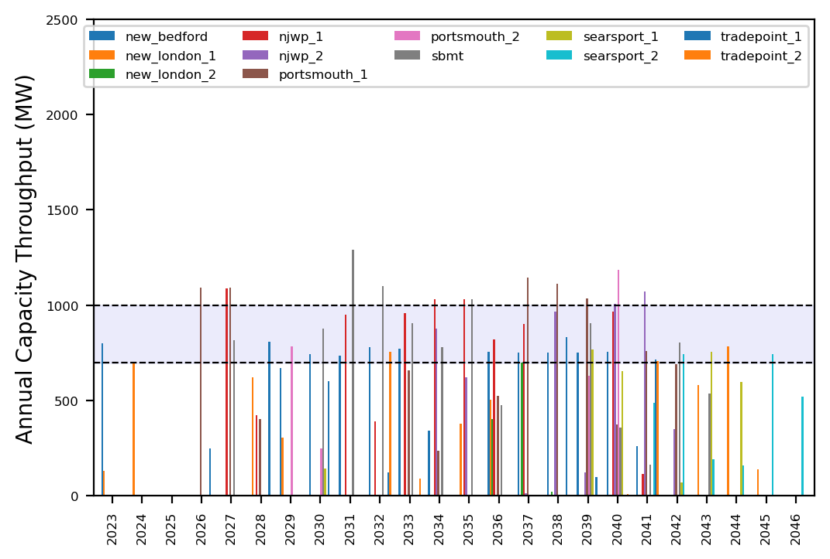
Port Throughput

Slide 14
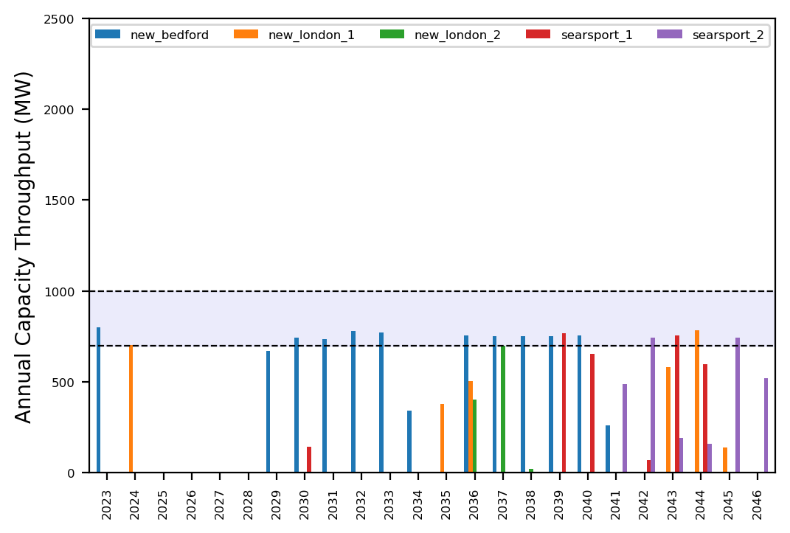
Port Throughput

Slide 15
ne_low_4wtiv_2ahts
Low Deployment Scenario

Slide 16
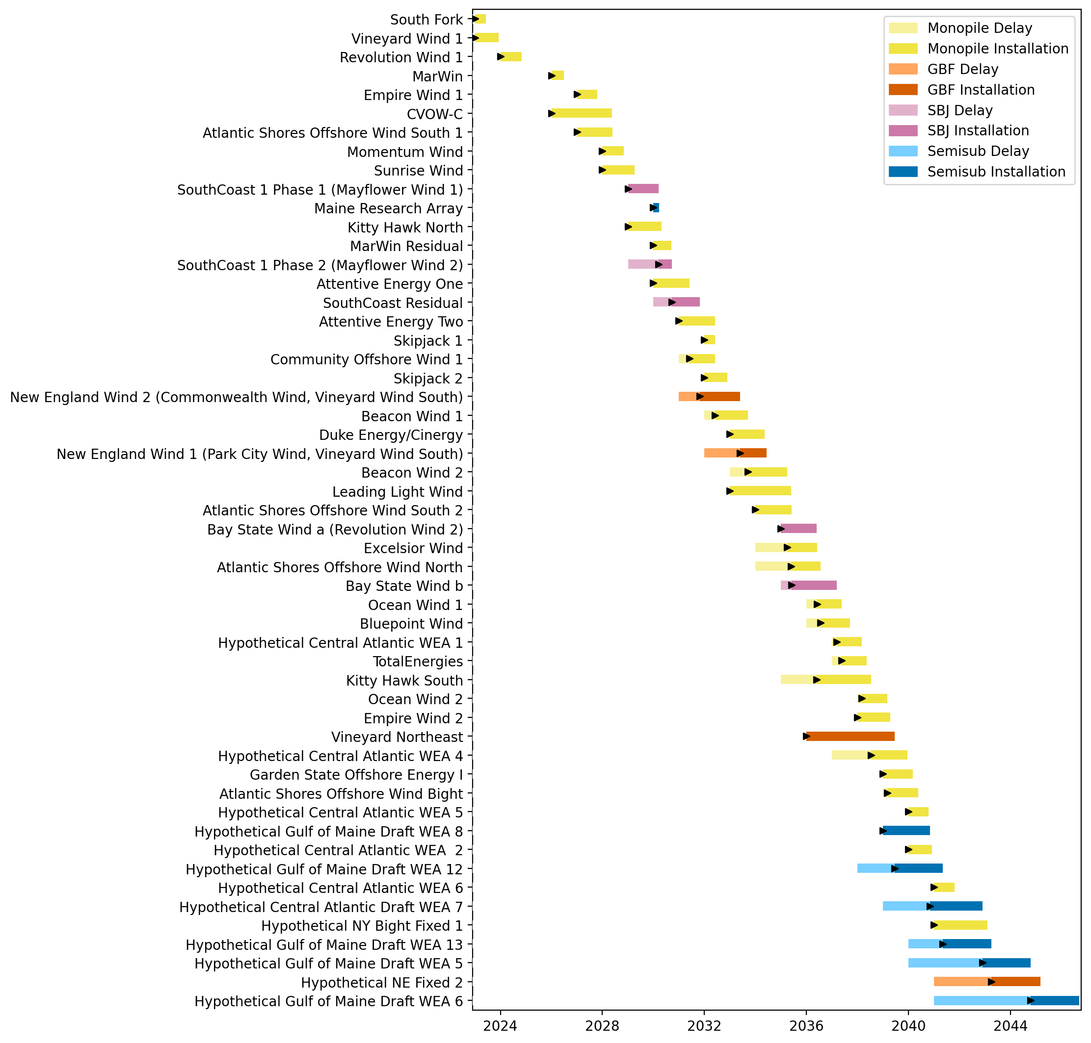
Full Gantt

Slide 17
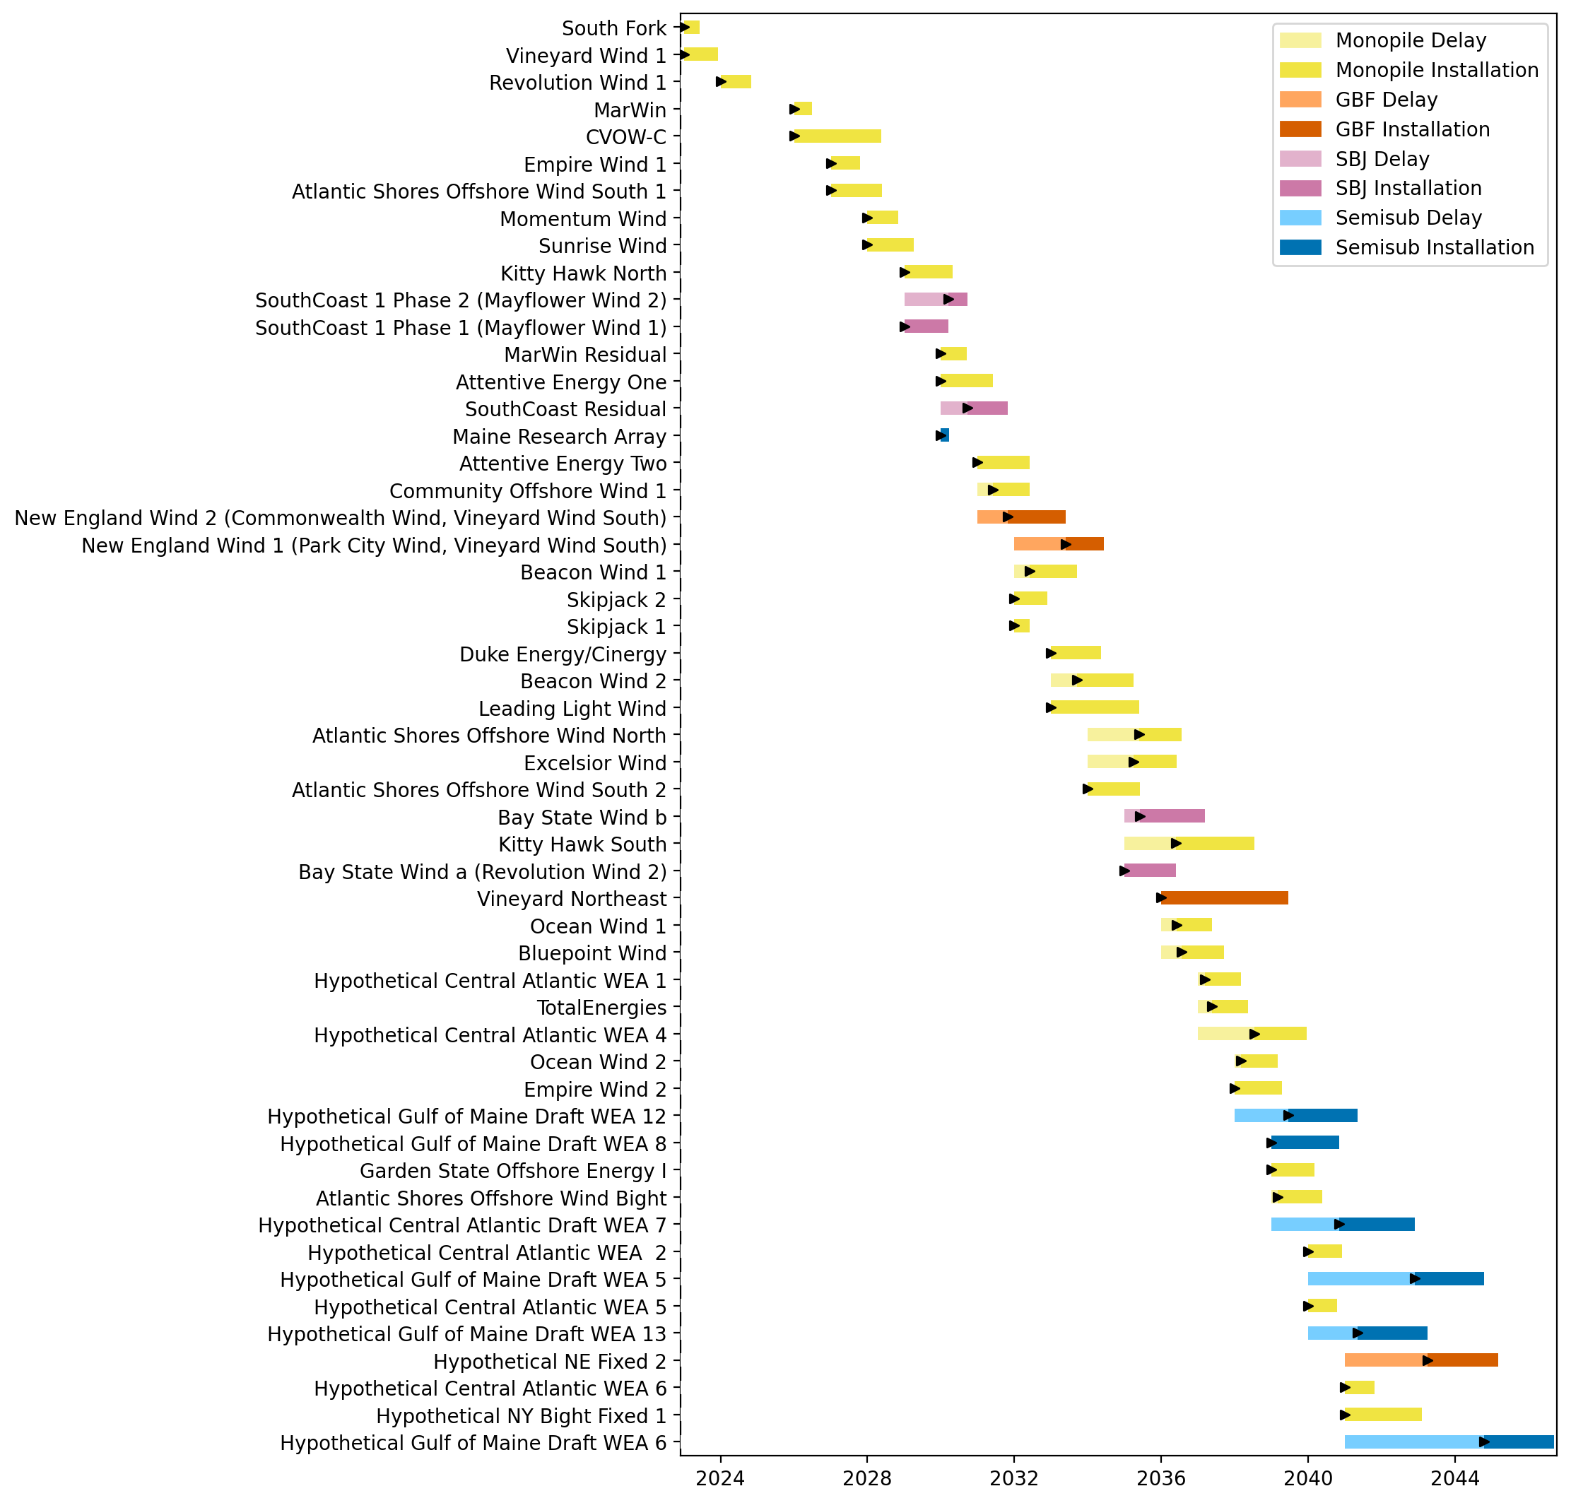
Sorted Full Gantt

Slide 18

New England Gantt

Slide 19

Sorted New England Gantt

Slide 20
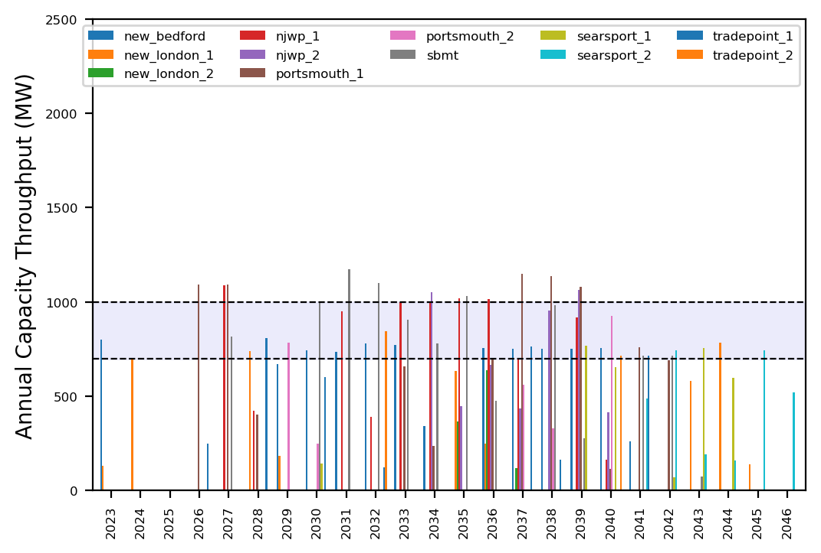
Port Throughput

Slide 21

Port Throughput

Slide 22
ne_low_4wtiv_3ahts
Low Deployment Scenario

Slide 23
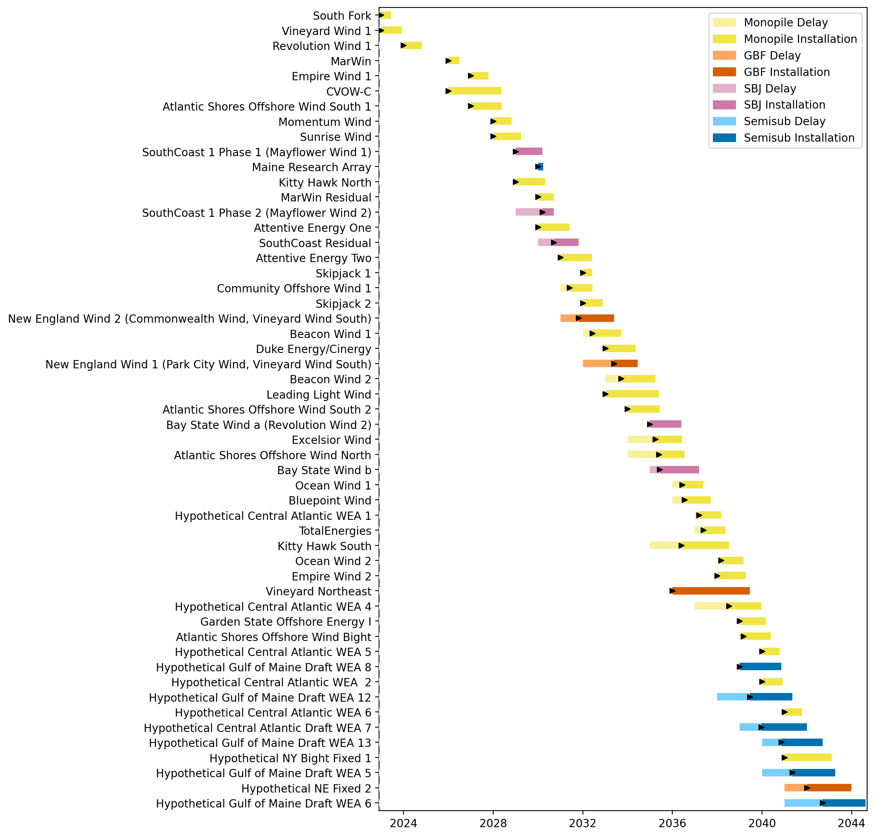
Full Gantt

Slide 24
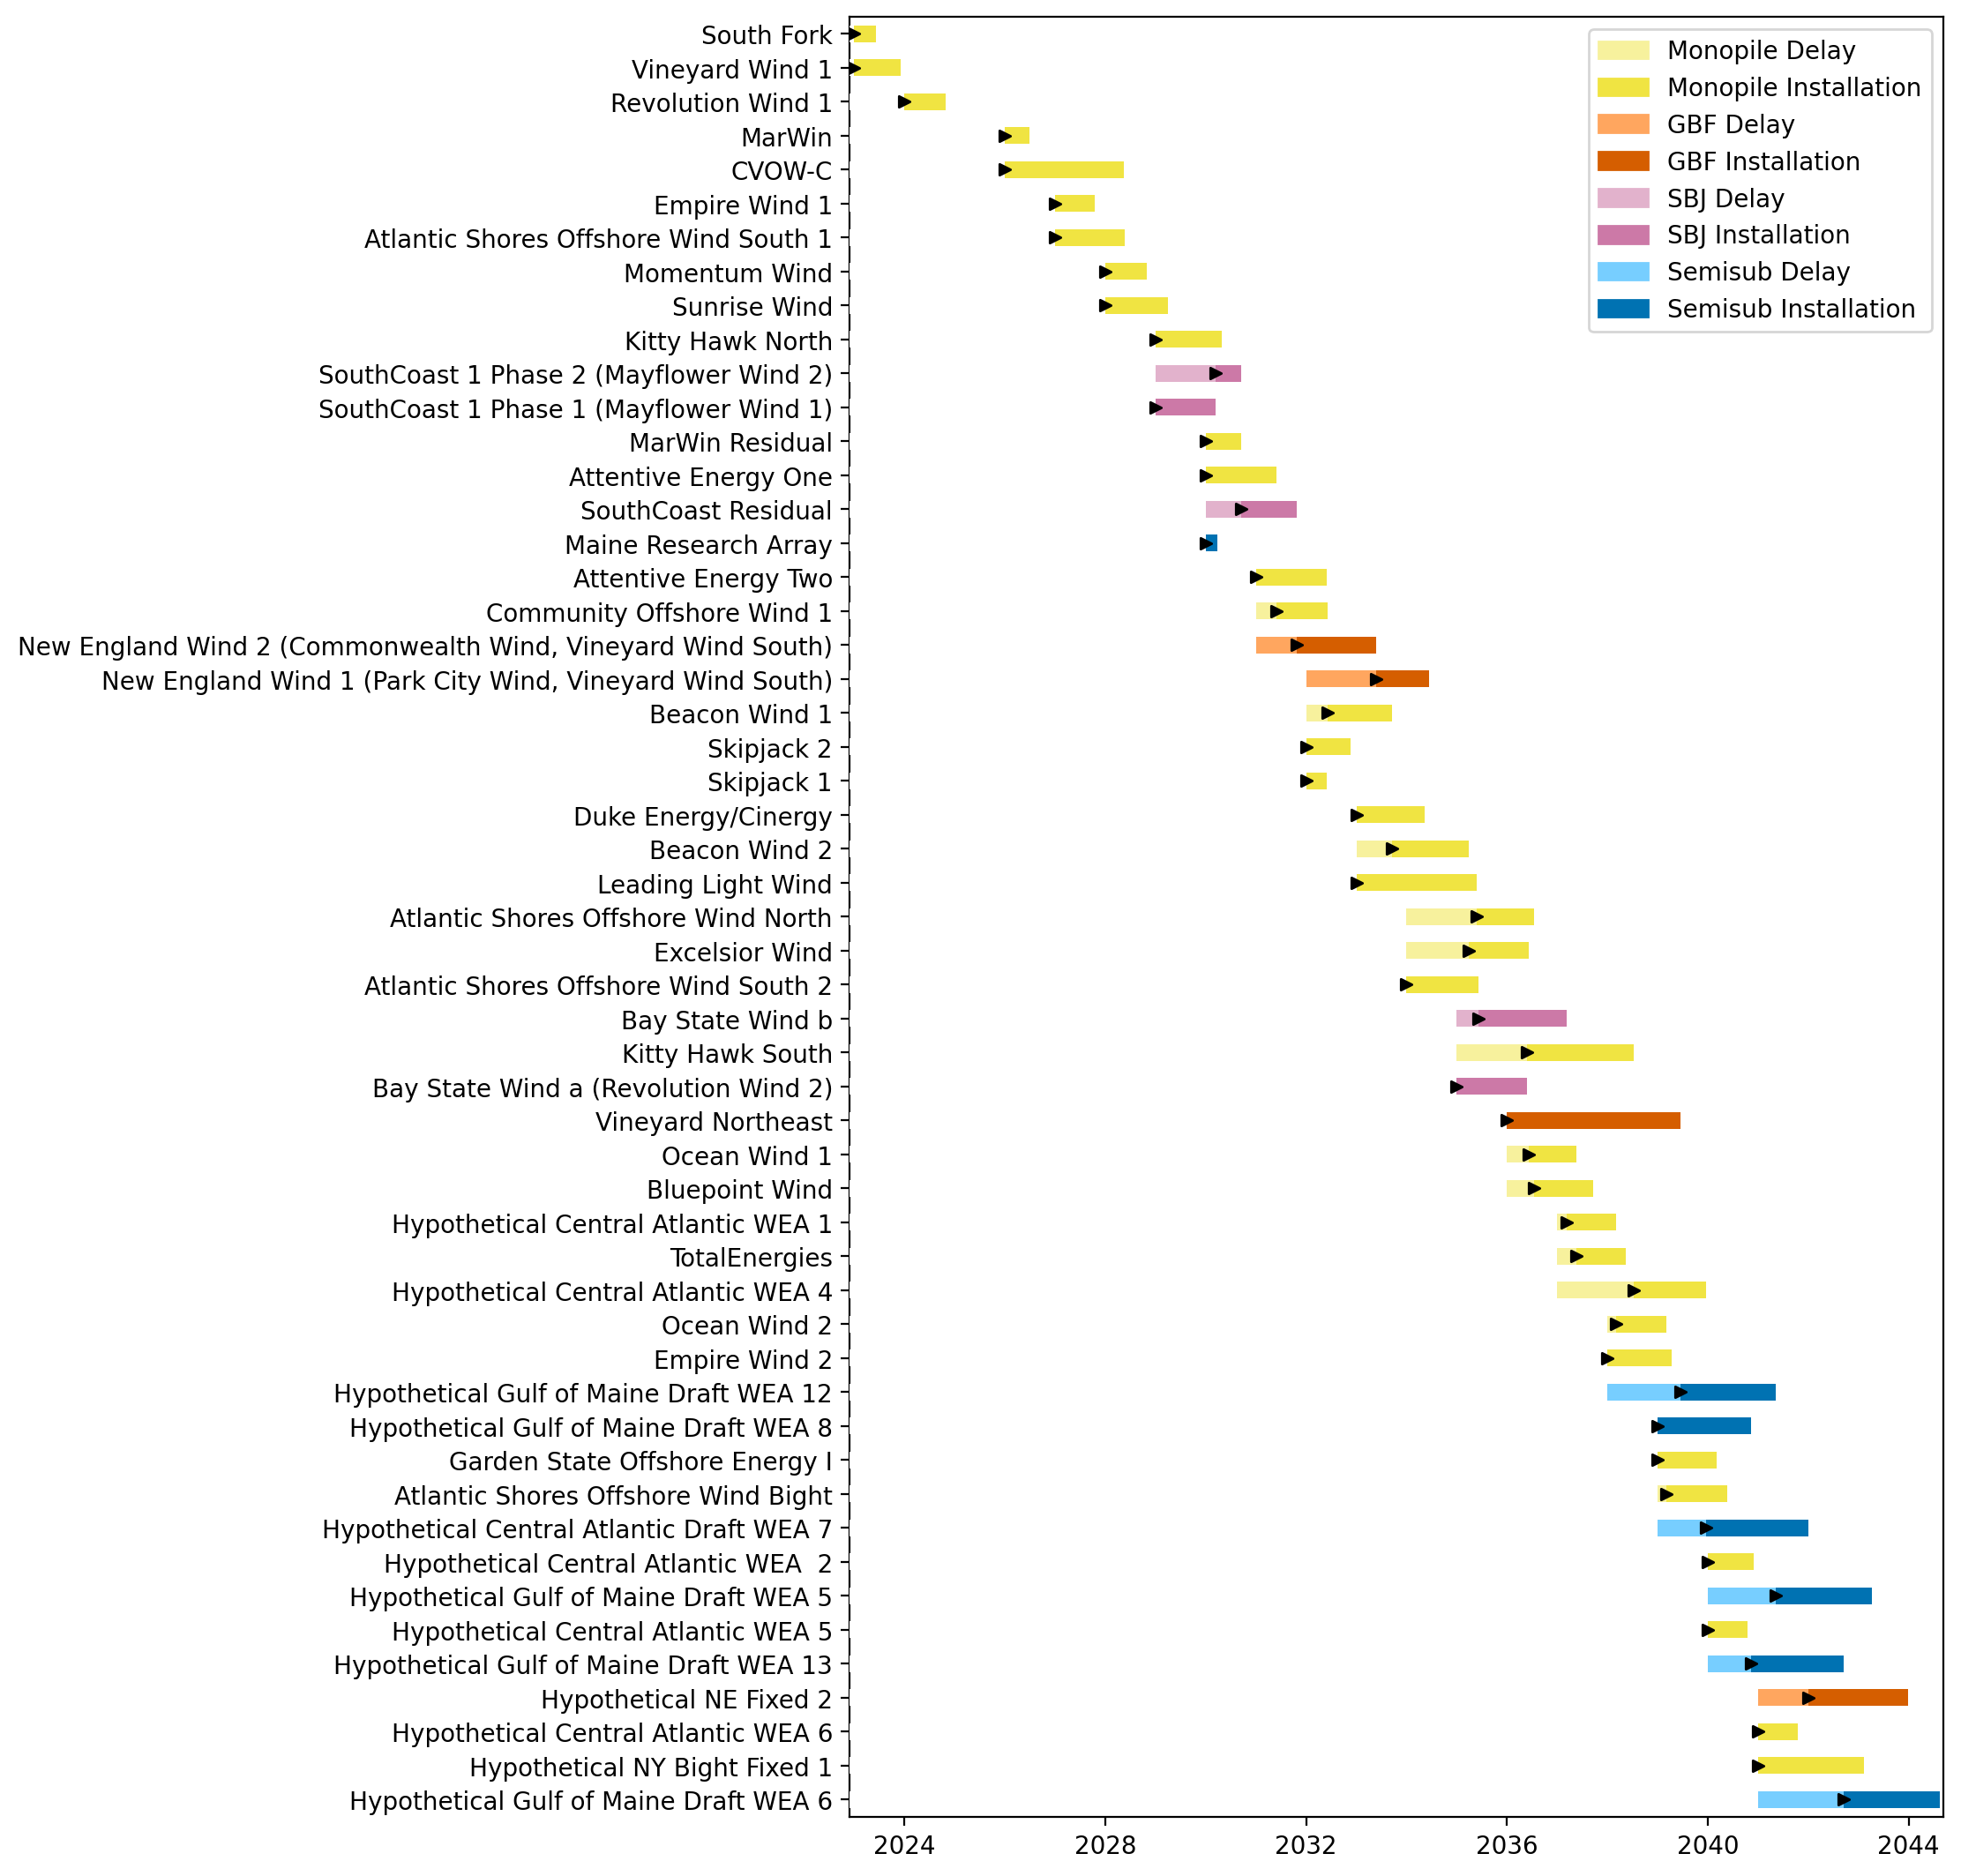
Sorted Full Gantt

Slide 25
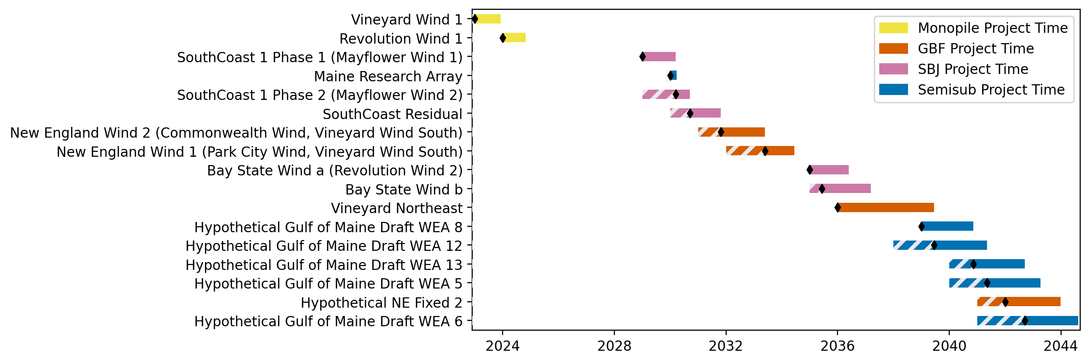
New England Gantt

Slide 26
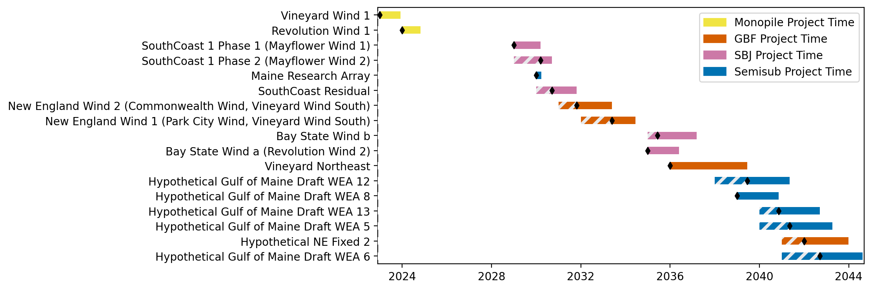
Sorted New England Gantt

Slide 27
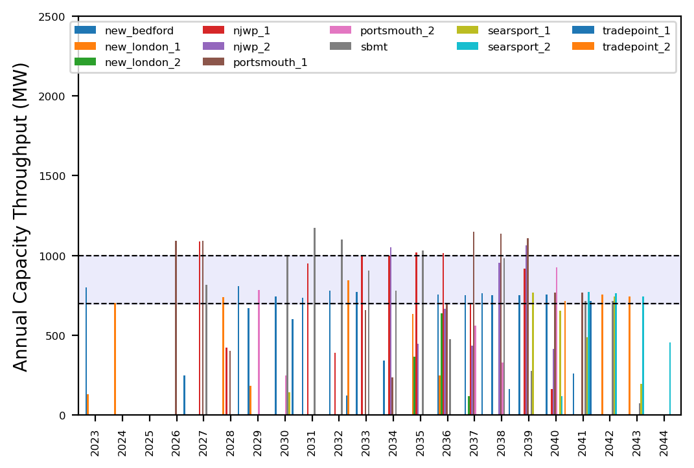
Port Throughput

Slide 28
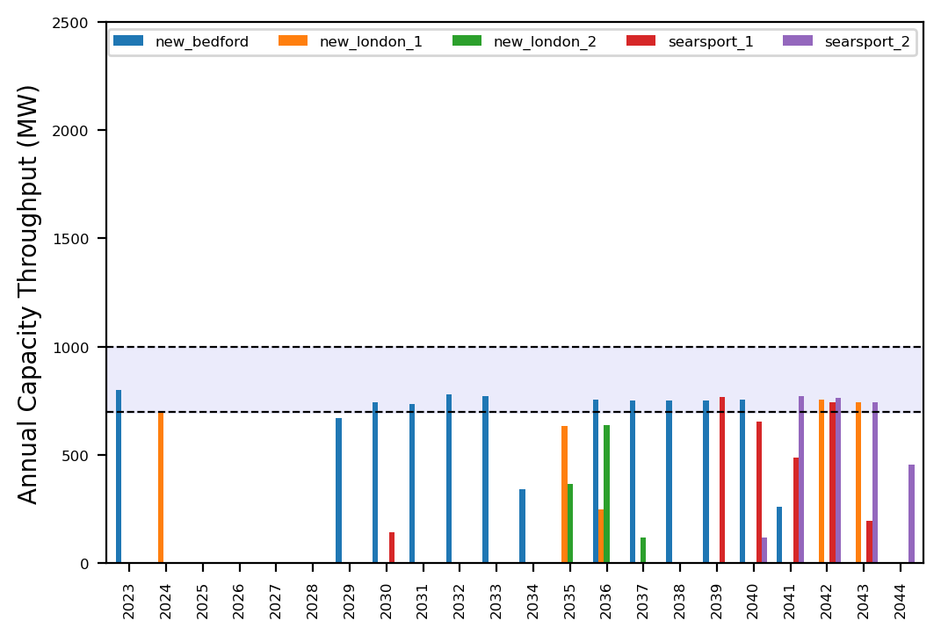
Port Throughput

Slide 29
ne_low_4wtiv_4ahts
Low Deployment Scenario

Slide 30
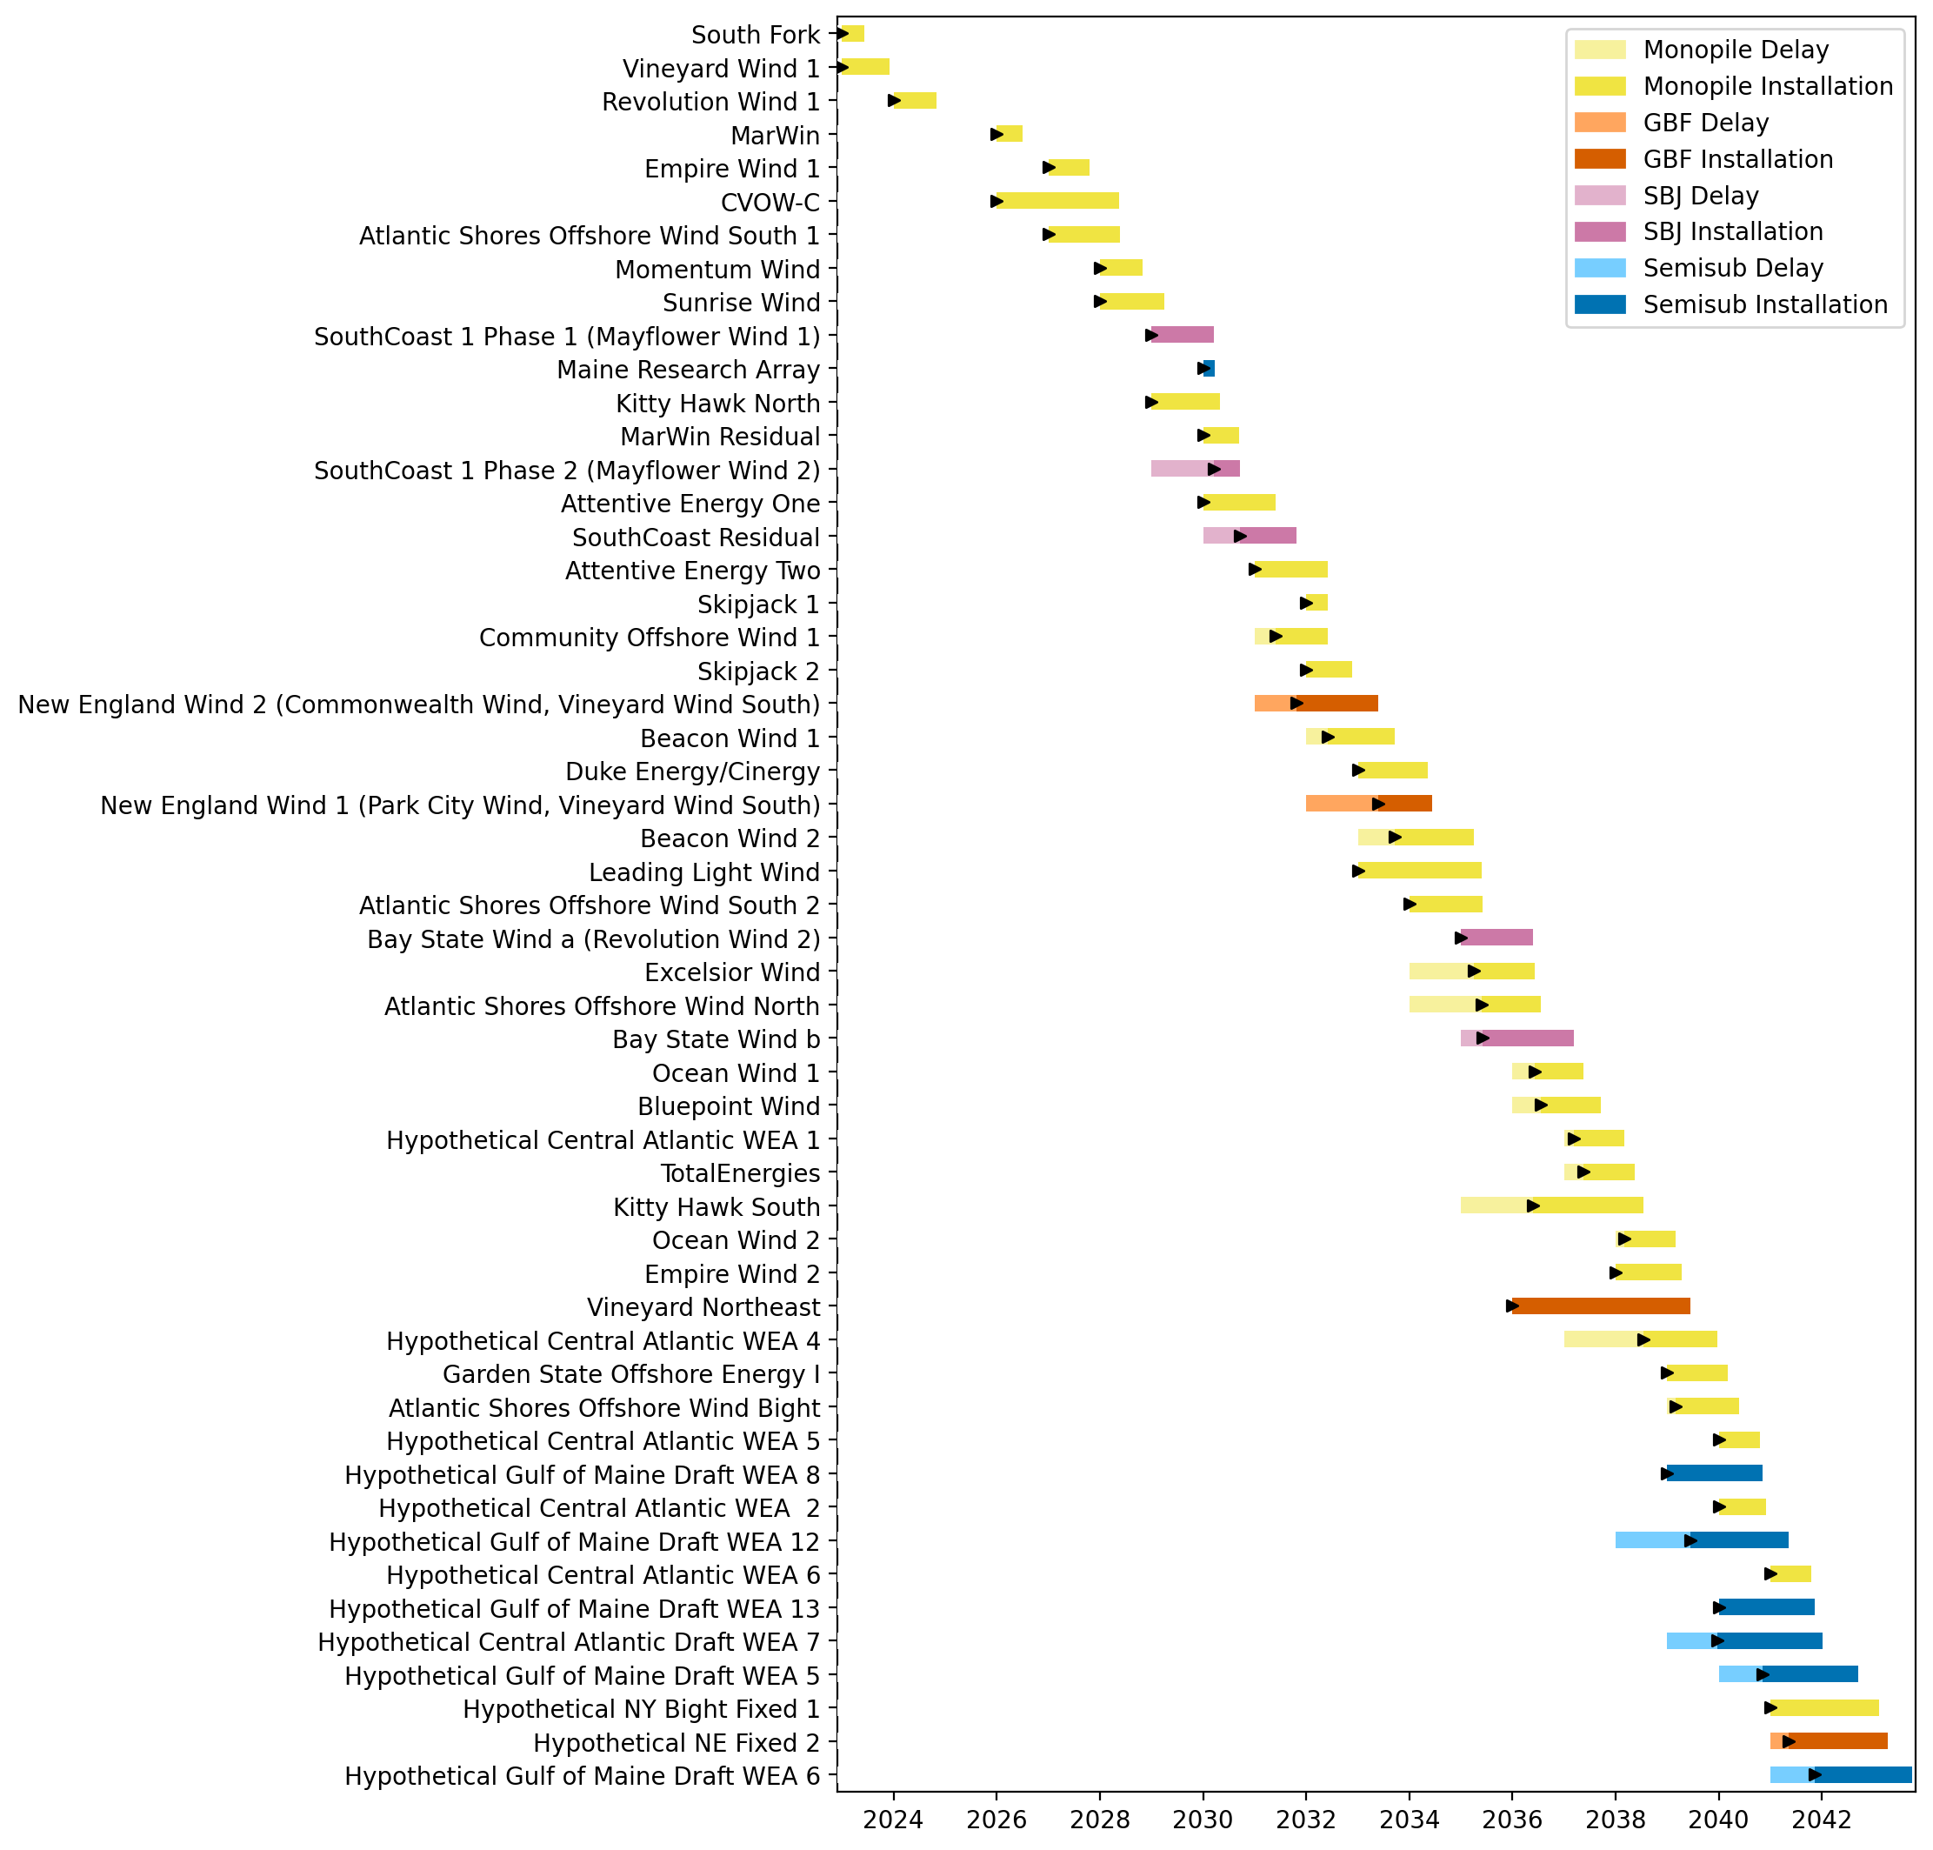
Full Gantt

Slide 31
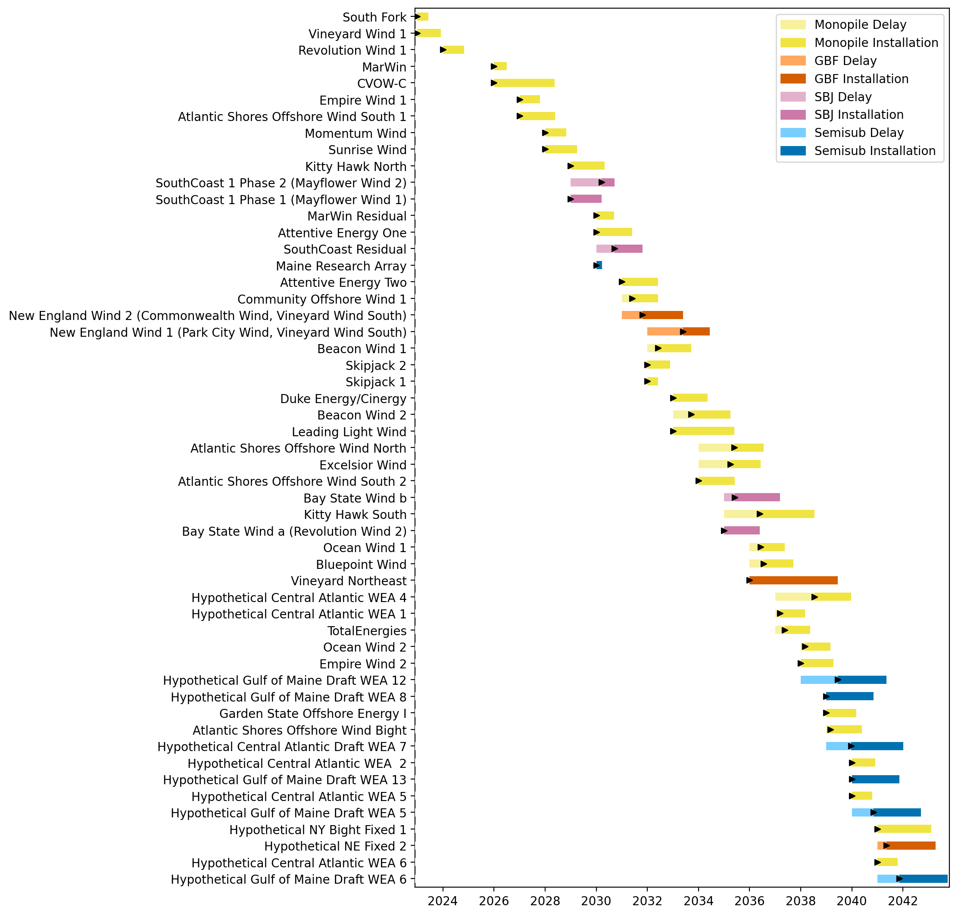
Sorted Full Gantt

Slide 32
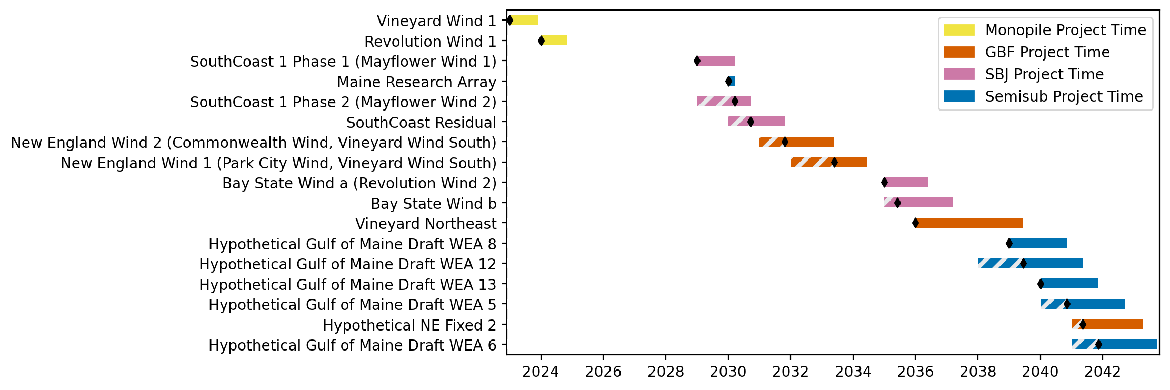
New England Gantt

Slide 33
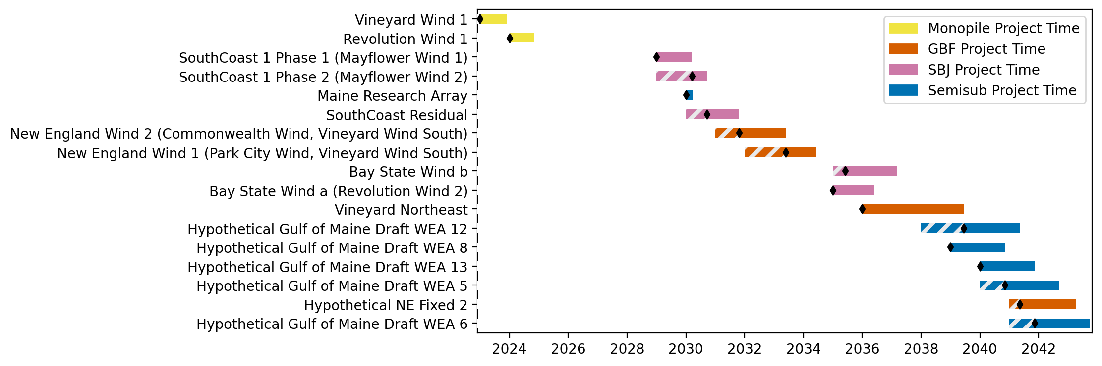
Sorted New England Gantt

Slide 34
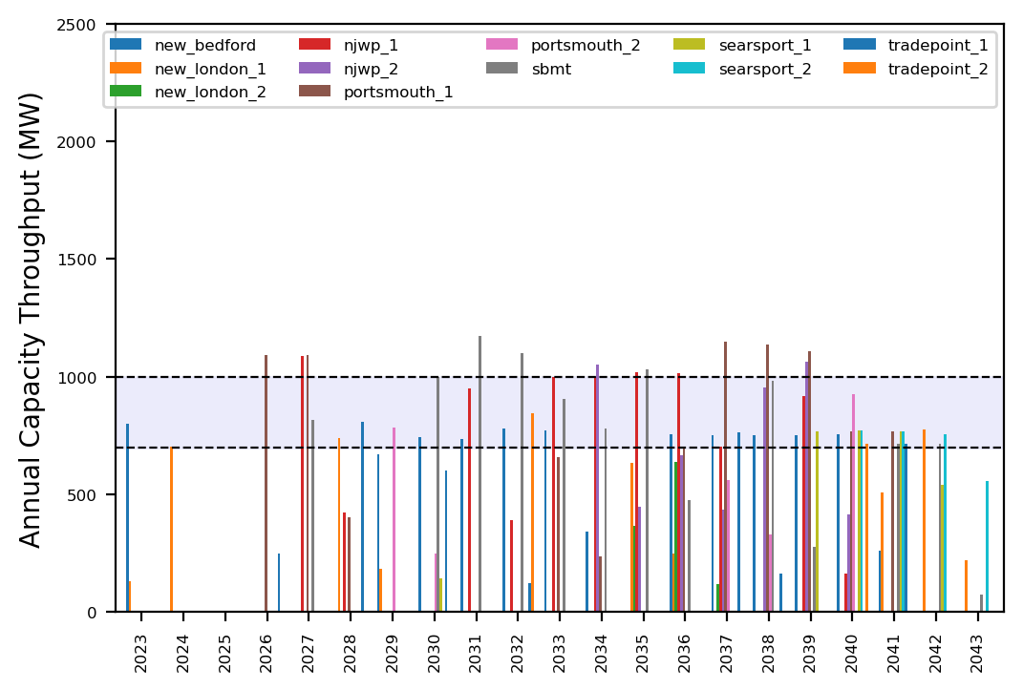
Port Throughput

Slide 35
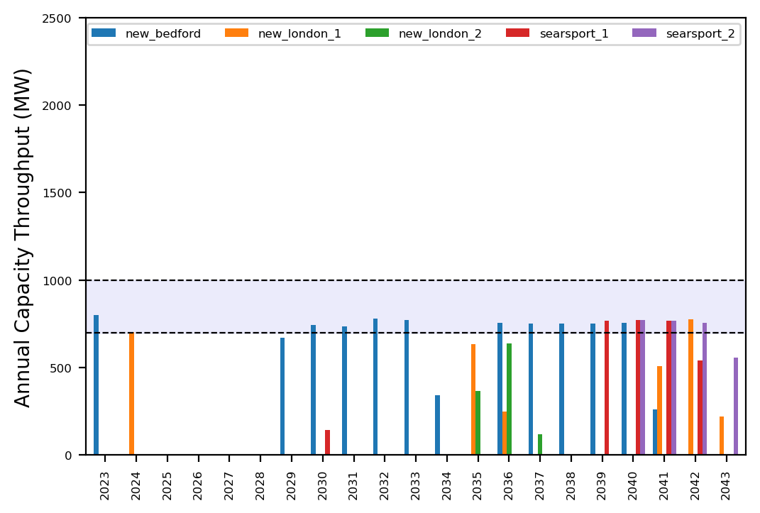
Port Throughput

Slide 36
ne_low_4wtiv_5ahts
Low Deployment Scenario

Slide 37

Full Gantt

Slide 38

Sorted Full Gantt

Slide 39
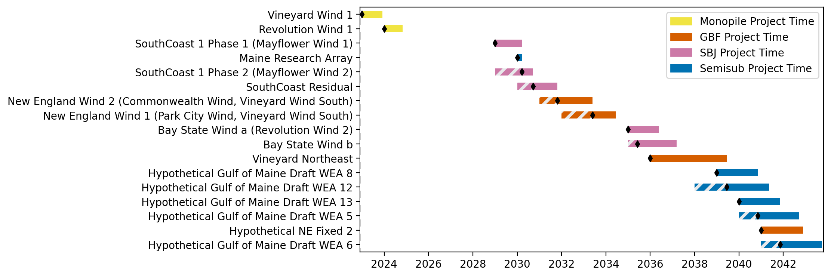
New England Gantt

Slide 40

Sorted New England Gantt

Slide 41
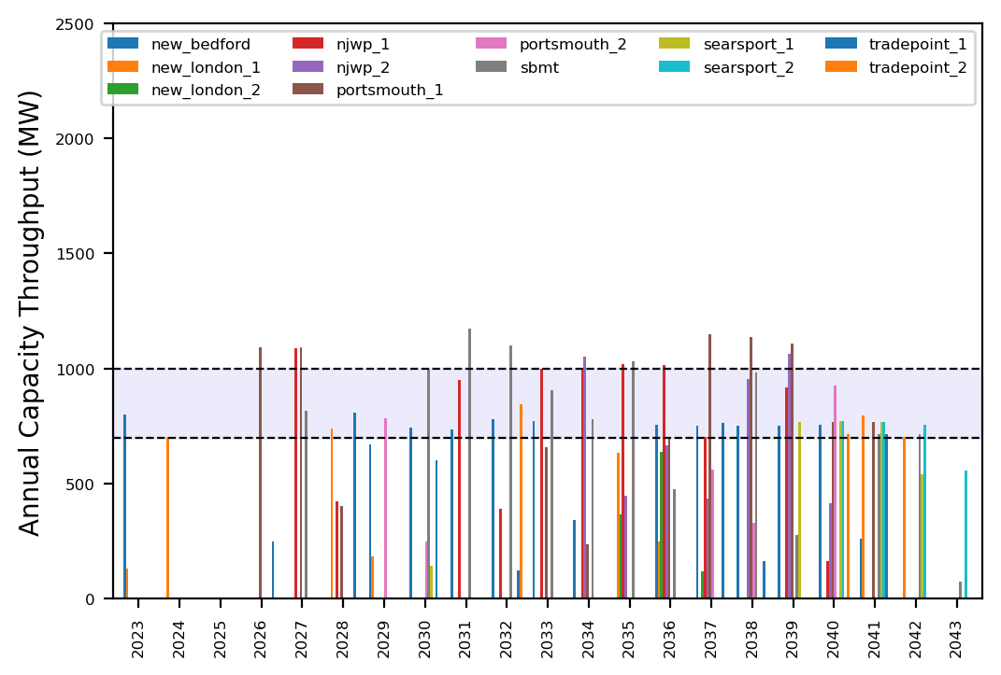
Port Throughput

Slide 42
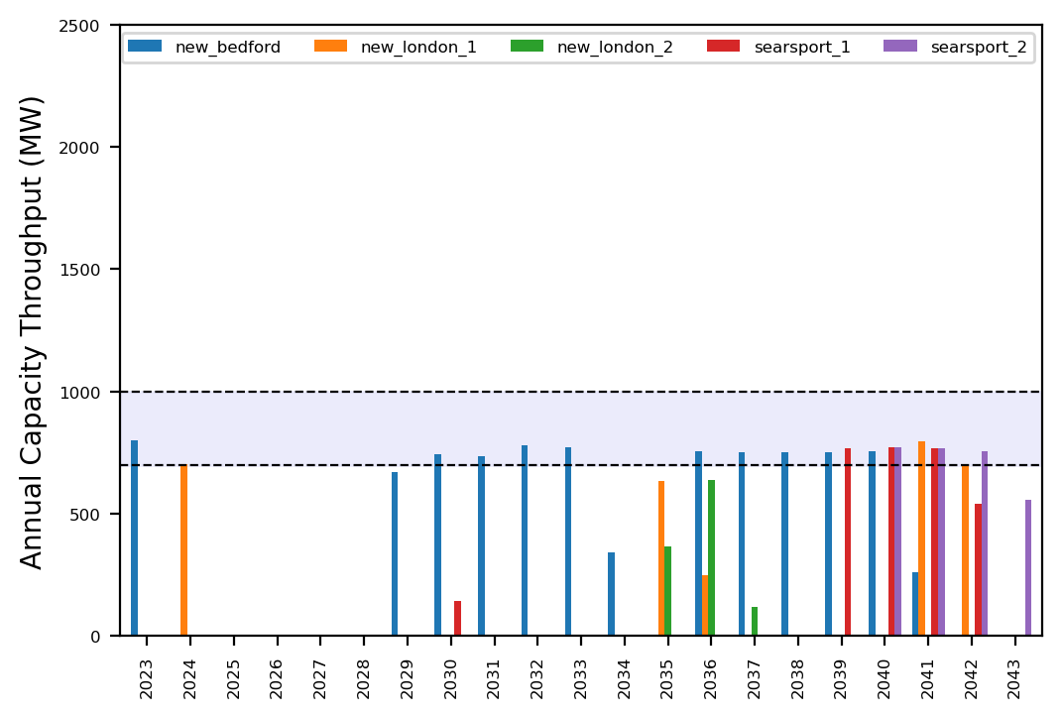
Port Throughput

Slide 43
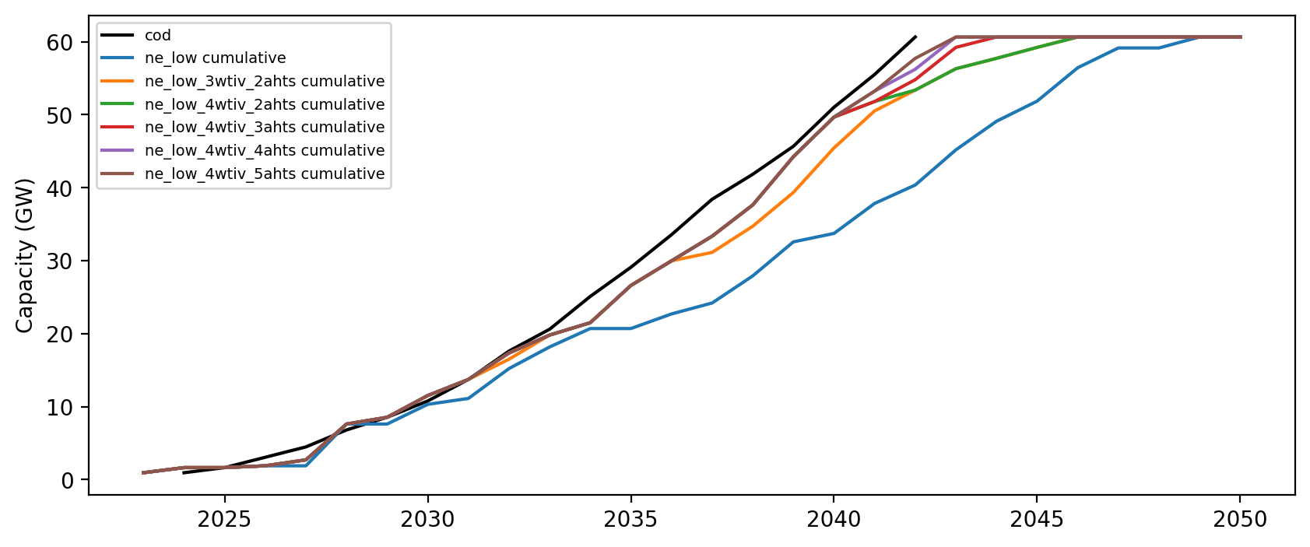
Installed Capacity

